Slide 1
Technical University Hospital of Greater Copenhagen

Slide 2
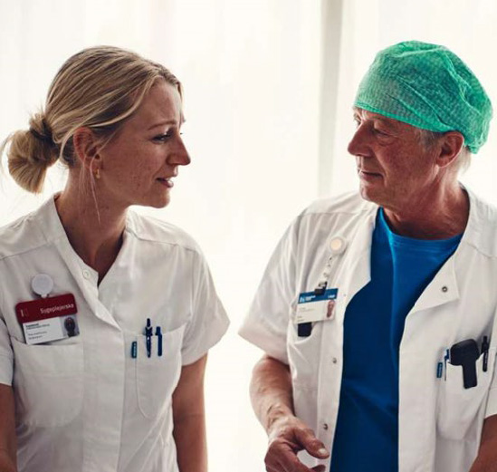

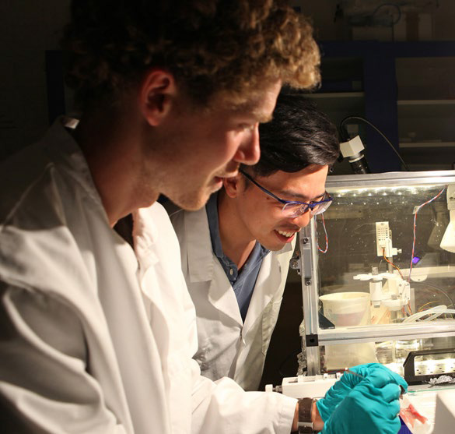
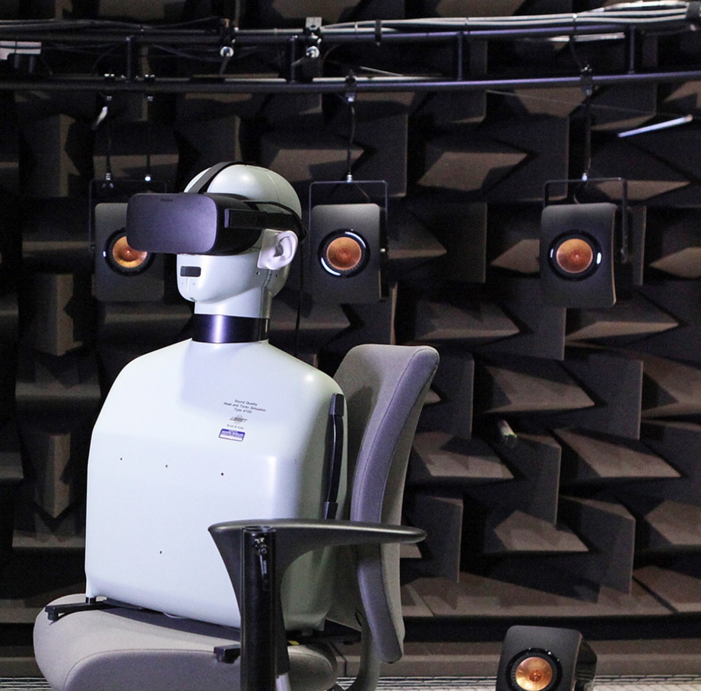
Technical University Hospital of Greater Copenhagen
Vision
TUH develops citizen-centered, sustainable, and technological solutions for prevention, diagnostics, and treatment, for the benefit of all—regardless of who they are or where they live.
Mission
TUH aims to be a powerhouse in health technology, built on an intensive, integrated, and agile collaboration between DTU and the Capital Region of Denmark (soon to be Region East Denmark), where health science and technical-natural science research and innovation merge and become a natural part of the development of all aspects of the healthcare system – from logistics to diagnostics and the development of new treatments.

Slide 3
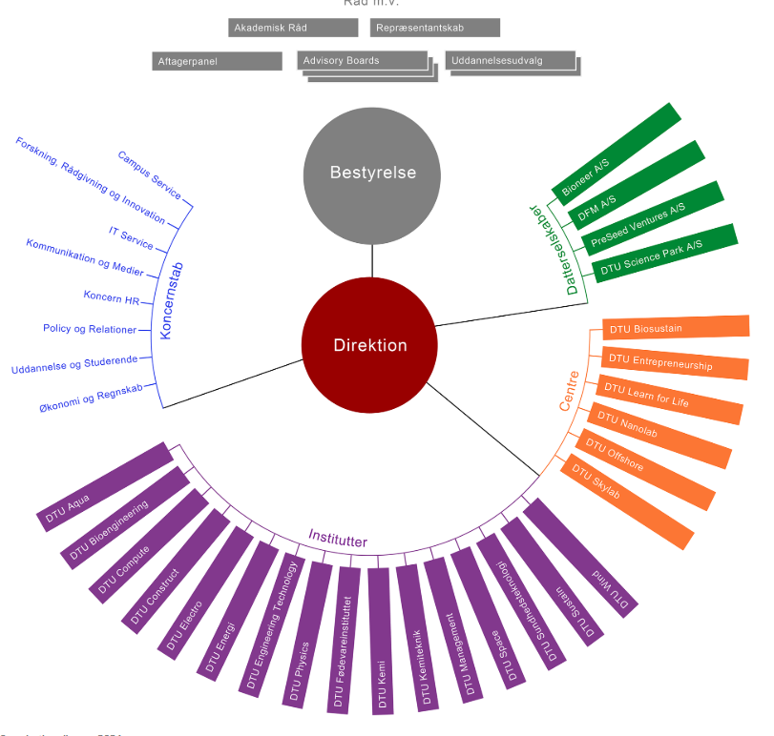
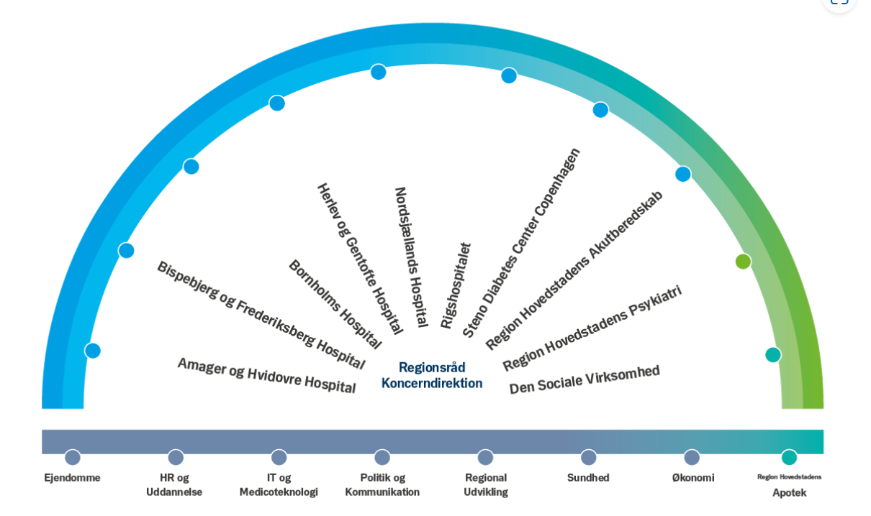
TUH – a broad collaboration

Slide 4
Members of The Board of Management
Chair : Erik Jylling, Regional Chief Operations Officer, Capitol Region
Vice Chair: Marianne Thellersen, Senior Vice President, Innovation & Entrepreneurship, DTU
Jan Madsen, Head of Department DTU Compute
Bjarke Bak Christensen, Head of Department DTU BioEngineering
Mette Wier, Head of Department, DTU Management
Jakob Hendel, Deputy director, Amager-Hvidovre Hospital
Bodil Ørkild, Deputy director, Herlev-Gentofte Hospital
Malene Fischer, Director for Research, Innovation and Education, Rigshospitalet
Marie-Helene Olsen, Deputy director, Bispebjerg og Frederiksberg Hospital (observer)
Jørgen Kurtzhals, Associate Dean for Education, University of Copenhagen,
Faculty of Health and Medical Sciences (observer)
Martin Magelund Rasmussen, Executive director, Region Sjælland (observer)
Bente Ourø Rørth, Director, Nordsjællands Hospital (observer)
Academy leaders
Professor Christian Hassager, Cardiology, Rigshospitalet
Professor Jan Henrik Ardenkjær-Larsen, Head of Department, DTU Health Tech
Board of Directors
Advisory Board
Academy for Technology in Health
Education and training forum
Coordinating professors
Innovation network

Slide 5
Building Blocks
TUH
Employees
Education
PhD & Post Docs
Associate clinical professors
Clinical Professors
New training programmes
Postgrad. Training
Educating the organisation:Fertilize to promote an innovative culture
R&I
Projects
Facilities
Infrastructure
SkyLab 2.0: Patient at home
Computing
MedTech Work Shop
Meeting space supporting diversity and patient involvement
Data
Employment conditions
Governance
Administration and support

Slide 6
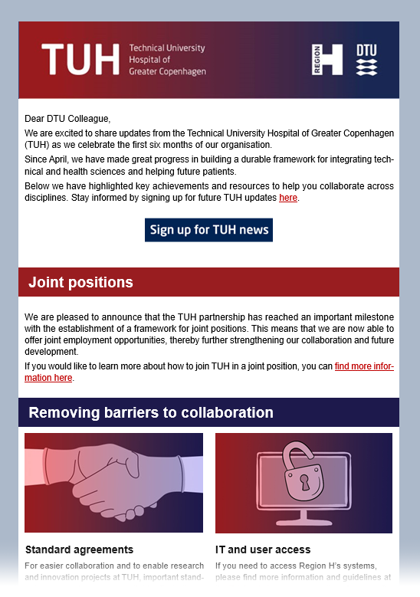

Interested in finding out more?
News letter:
sign up here

